Slide 1




Rockbuster Analysis
Chris Schwarz
Data Analyst

Slide 2
Project Overview
Rockbuster Stealth LLC is a movie rental company that used to have stores around the world. Facing stiff competition from streaming services such as Netflix and Amazon Prime, the Rockbuster Stealth management team is planning to use its existing movie licenses to launch an online video rental service in order to stay competitive.
The goal of this project is to analyze Rockbuster’s database to help with the launch strategy for the new online video service
Tools Used: PostgreSQL, Tableau
Tableau Public Link: https://public.tableau.com/views/Exercise3_10_17134619649850/ChinaTopGenres?:language=en-US&publish=yes&:sid=&:display_count=n&:origin=viz_share_link

Slide 3
Key Questions
Which movies contributed the most/least to revenue gain?
What was the average rental duration for all videos?
Which countries are Rockbuster customers based in?
Where are customers with a high lifetime value based?
Do sales figures vary between geographic regions?

Slide 4
Descriptive Statistics
Film Table
 | Release Year | Rental Duration | Rental Rate | Length (minutes) | Replacement Cost
Minimum | 2006 | 3 | .99 | 46 | 9.99
Maximum | 2006 | 7 | 4.99 | 185 | 29.99
Average | 2006 | 4.98 | 2.98 | 115.27 | 19.99

Slide 5
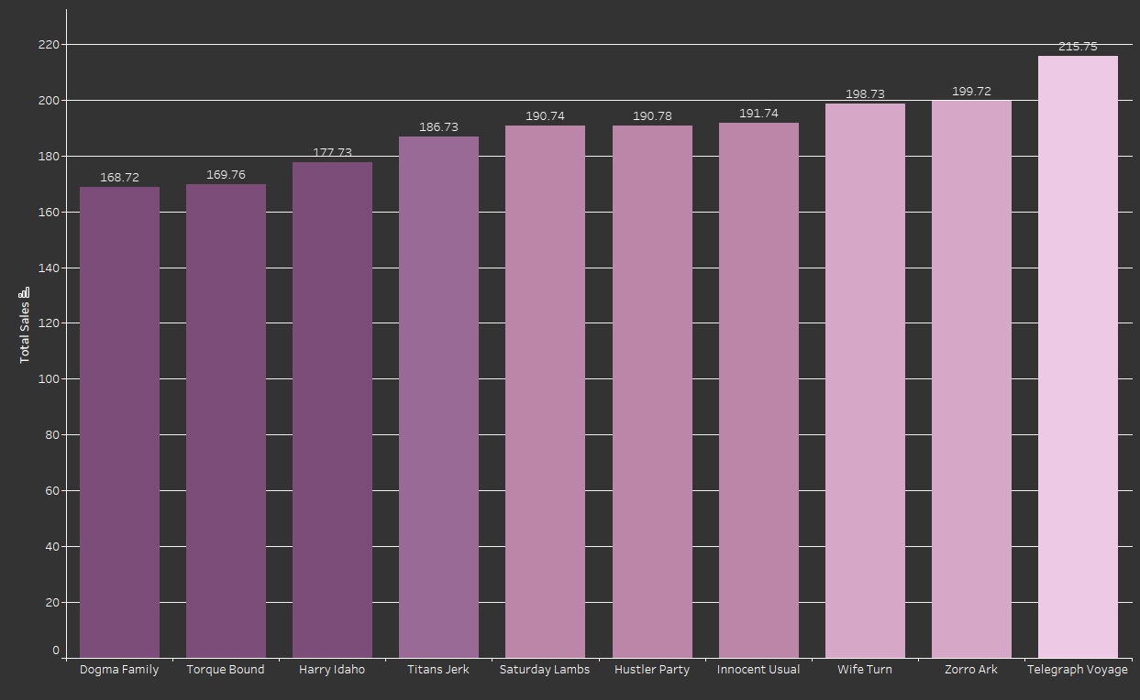
Which movies contributed most to revenue gain?
Title | Revenue
Telegraph Voyage | 215.75
Zorro Ark | 199.72
Wife Turn | 198.73
Innocent Usual | 191.74
Hustler Party | 190.78
Saturday Lambs | 190.74
Titans Jerk | 186.73
Harry Idaho | 177.73
Torque Bound | 169.76
Dogma Family | 168.72

Slide 6
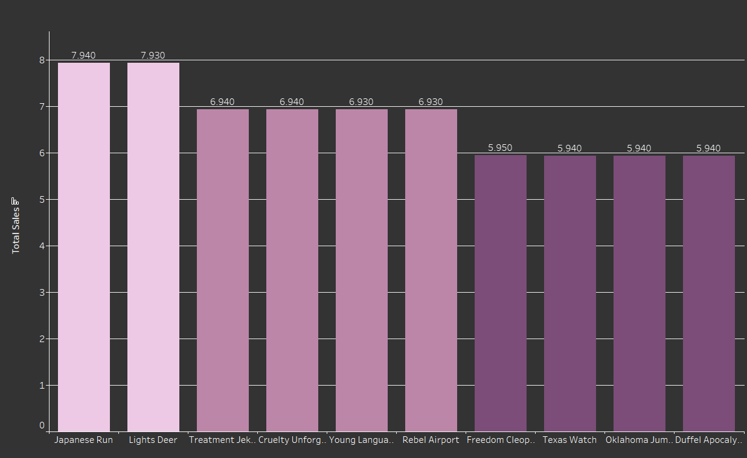
Which movies contributed least to revenue gain?
Title | Revenue
Duffel Apocalypse | 5.94
Oklahoma Jumanji | 5.94
Texas Watch | 5.94
Freedom Cleopatra | 5.95
Rebel Airport | 6.93
Young Language | 6.93
Cruelty Unforgiven | 6.94
Treatment Jekyll | 6.94
Lights Deer | 7.93
Japanese Run | 7.94

Slide 7
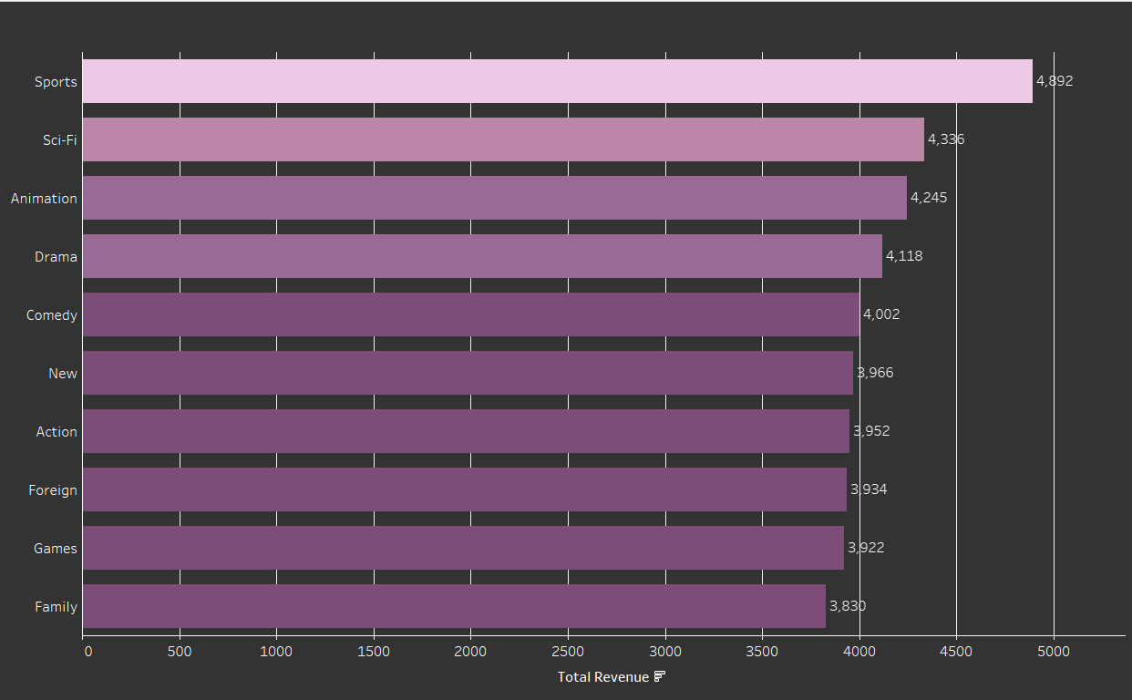
Which genres have the highest revenue?
Top Genre:
SPORTS

Slide 8
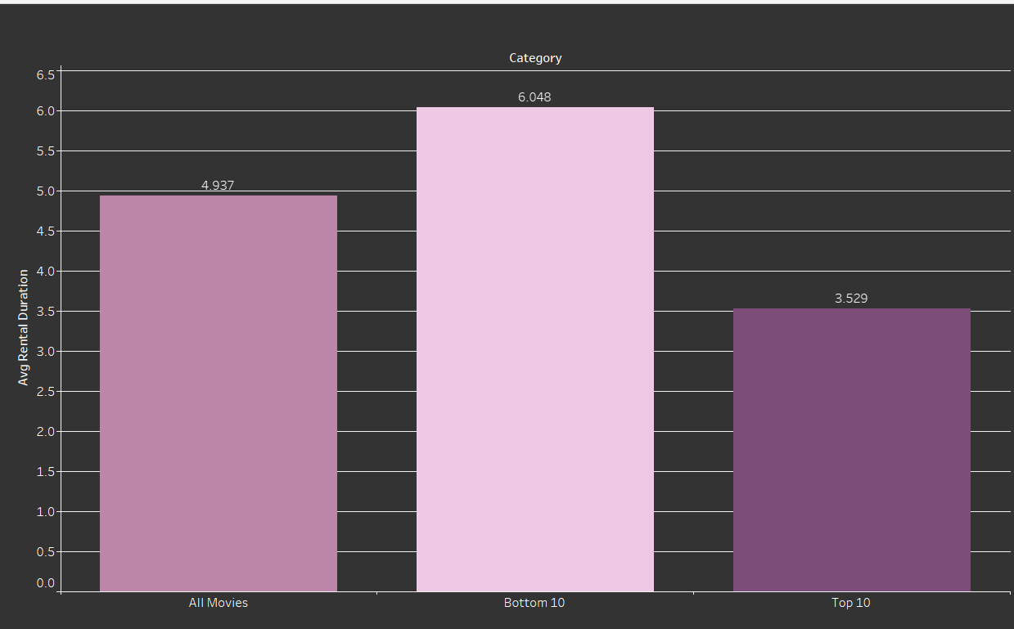
What was the average rental duration for all films?
This chart shows the average rental duration for the top 10 selling films, the bottom 10 selling films and an average for all films in the database. Interestingly, the bottom 10 selling films are rented for a longer duration then the top 10 sellers.

Slide 9
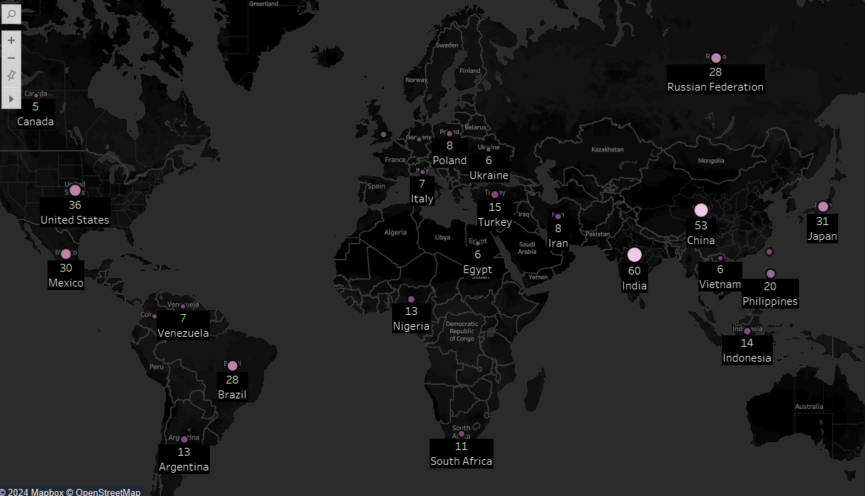


Where are Rockbuster customers based?
Top 25 Countries by Count of Customer
Customer Count
Total Revenue

Slide 10
Where are customers with a high lifetime value located?
Customer | Location | Total Amount Paid
Customer #1 | Ambattur, India | $111.76
Customer #2 | Shanwei, China | $109.71
Customer #3 | Iwaki, Japan | $106.77
Customer #4 | Acua, Mexico | $100.77
Customer #5 | Aurora, United States | $98.76
Customer #6 | Citrus Heights, United States | $96.77
Customer #7 | So Leopoldo, Brazil | $93.79
Customer #8 | Tianjin, China | $88.81
Customer #9 | Cianjur, Indonesia | $73.76
Customer #10 | Teboksary, Russia | $63.79

Slide 11
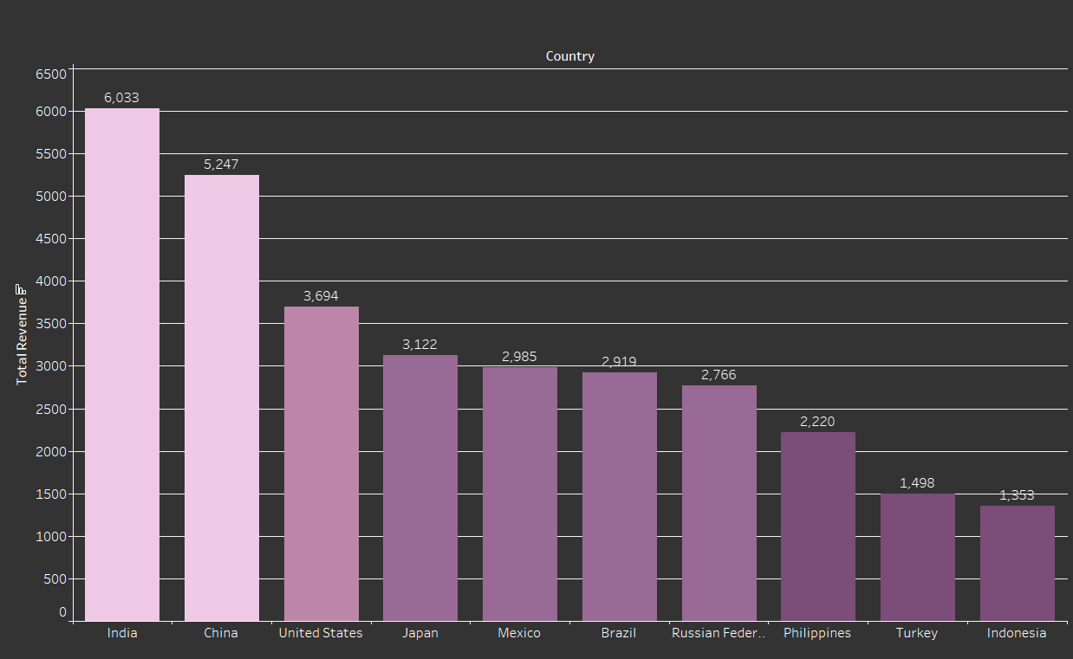
Top 10 Countries by Revenue

Slide 12
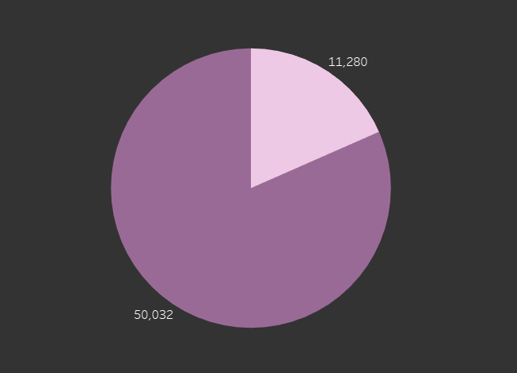

Do sales figures vary by region?
Total Revenue of China/India vs. Rest of World

Slide 13
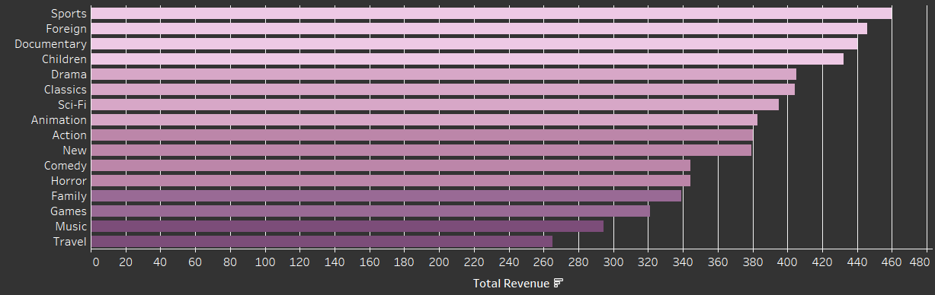
Top Selling Genres in India
#1 Genre
#2 Genre
#3 Genre
Sports
Foreign
Documentary

Slide 14
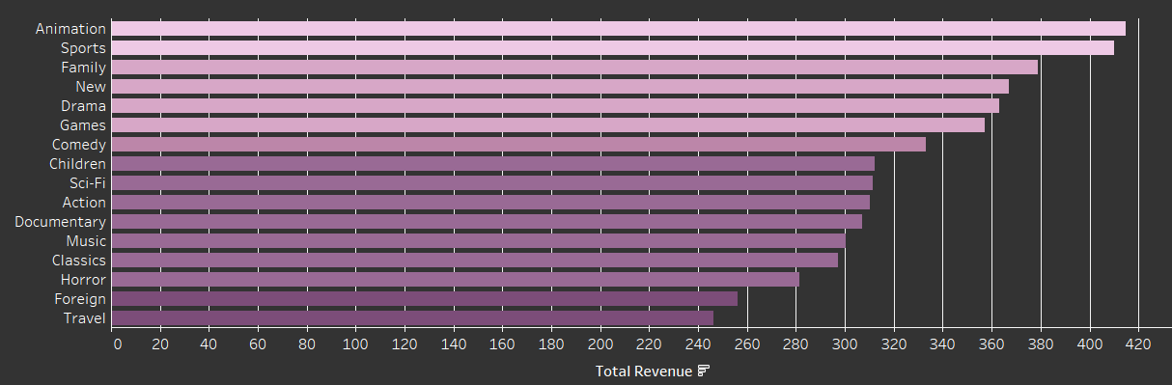
Top Selling Genres in China
#1 Genre
#2 Genre
#3 Genre
Animation
Sports
Family

Slide 15
Recommendations
Expand content selections for most popular genres: Sports, Sci-Fi and Animation.
Focus on the top ten revenue generating countries, especially China and India where Rockbuster has the most customers. Expand content for top genres in China & India. Create subtitles for films and expand selection of foreign language films.
Reexamine rental duration and pricing. Research variable rental durations with variable pricing. Offer discounts on low selling films.
Use data from customers to generate personalized recommendations based on genre preferences and region
Increase advertising in top countries: China, India, USA, Japan & Mexico

Slide 16

Thanks!
Do you have any questions?
cschwarzjr1992@gmail.com
123-456-7890
Please keep this slide for attribution

Slide 17
Icon pack

